Slide 1

Professional Responsibilities and Codes of Ethics “The Code of Ethics and Professional Conduct is intended to provide guidance to help resolve ethical dilemmas that are likely to be confronted within the course of their employment.”
Sanjeeva Perera - Senior Academic Fellow
Department of Computer Systems Engineering,
Faculty of Computing

Slide 2

Attendance WE https://forms.office.com/r/bxVTM2Cr8Z

Slide 3

Attendance WD https://forms.office.com/r/8yZnWPh8Fq

Slide 4
Professional Responsibilities and Codes of Ethics

Slide 5
Agenda
Profession, Professional, and Professionalism
Attributes of a Profession
Impact of your profession
Ethics and Codes of Ethics
Purpose of professional codes
Activity

Slide 6
Terms
Profession: A calling requiring specialized knowledge and often long and intensive academic preparation
Professional: A person who engaged in one of the learned professions conforming to the technical or ethical standards of a profession
Professionalism: The conduct, aims, or qualities that characterize or mark a profession or a professional person

Slide 7

Who is a Professional ?
Who posses certain attributes such as
Expert Knowledge
Autonomy with respect to “ independence in conducting one’s professional practice”
Have special responsibilities or moral obligations that exceed those of ordinary individuals.

Slide 8

Amateur - a person who takes part in an activity because they are interested in it or enjoy it, not as a job.
DAVID AIREY is a graphic designer and writer, hired by clients of all sizes, from multinationals to companies of one. Since opening my business in 2005 I’ve created logos and visual identities for brands in more than 30 countries.
Notes:
A – MUH – TUR

Slide 9
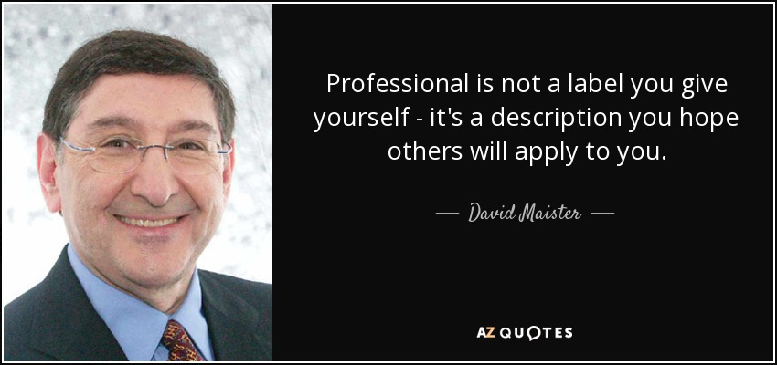

Slide 10
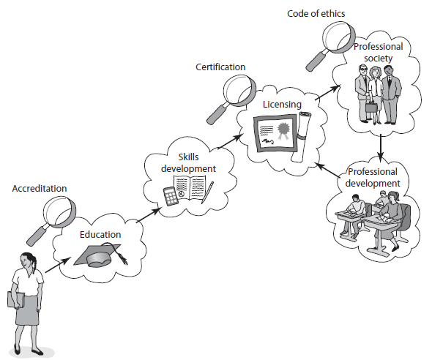
Attributes of a Profession
A professional association or professional body (IET, CSSL, SLMC, IESL) seeks to further a particular profession, the interests of individuals engaged in that profession and the public interest

Slide 11
Who is a Computing Professional ?
Anyone who is employed in computer, information technology or information/communication fields.
Can include
Software / Hardware designers
software engineers,
software quality/ system analysts,
Database administrators
software technical writers,
software managers,
Computer scientists

Slide 12
Impact of your job/work
Computer systems that can have direct life-threatening impact.
Air craft and air traffic control systems
Mass transportation systems
Nuclear reactors, missile systems
Medical treatment systems
Design of bridges and buildings
Development of analytical models for medical treatment

Slide 13
Responsibilities of Computing Professionals
To Clients and Users
To Employers
To Other Professionals
To the Public

Slide 14
Ethics
Ethics is a set of beliefs about right or wrong behavior
Ethical behavior conforms to generally accepted social norms - > Universally accepted
Eg : Lying and cheating are unethical

Slide 15
Why Ethics ?
Helps people to make moral decisions
Assumes that people are rational and free to choose how they will act
Describes how people do act and how people should act.

Slide 16

CODE of ETHICS
Professional Ethics cover the personal, organizational and corporate standards that are expected of professionals.
Includes issues involving relationships or responsibilities with:
Employees, employers, and other people who use the products or services.
“Computer Ethics” includes social, political, and personal issues.

Slide 17





Professional codes of Ethics for IT
Computer Society of Sri Lanka ( CSSL )
The Institute of Engineering and Technology (IET)
The Association for Computer Machinery ( ACM)
The Institute for Electrical and Electronic Engineers- Computer Society ( IEEE- CS)
British Computer Society ( BCS )

Slide 18
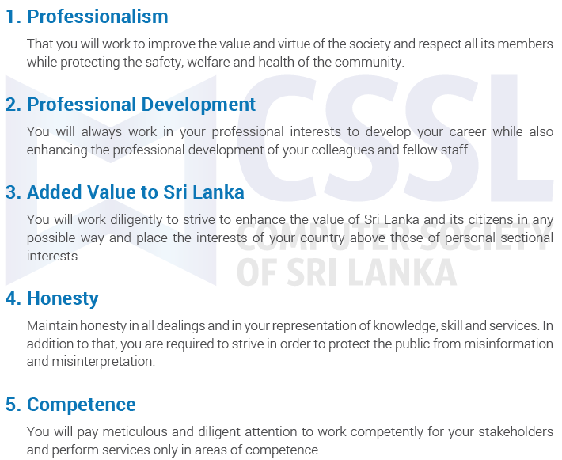
CSSL Codes of Ethics

Slide 19

IEEE Codes of Ethics
Accept responsibility in making engineering decision consist with the safety, and welfare
Avoid real conflicts of interest wherever possible
Be honest
Reject bribery in all forms

Slide 20

ACM Code
Contribute to society and human well being
Avoid harm to others
Be honest and trustworthy
Be fair and take action not to discriminate
Honour property copy and patents
Give proper credits to IP
Respect the privacy of others
Honour confidentiality

Slide 21
ACM – SE-CODE
Software Engineering code of ethics ( by ACM )
1.PUBLIC – SE s shall act consistently with public interest
2. CLIENT AND EMPLOYER – SE s shall act in a manner that is the best interests of their client and employer consistent with the public interest.
3. PRODUCT – SE s shall ensure that their products and related modifications meet the highest professional standards possible

Slide 22
ACM – SE-CODE
4. JUDGMENT – SE s shall maintain integrity and independence in their professional judgement
5. MANAGEMENT – SE managers and leaders shall subscribe to and promote an ethical approach to the management of software development and maintenance.
6. PROFESSION – SE s shall advance the integrity and reputation of the profession consistent with the public interest.

Slide 23
ACM – SE-CODE
7. COLLEAGUES – SE s shall be fair to and supportive of their colleagues
8. SELF – SE s shall participate in life-long learning regarding the practice of their profession and shall promote an ethical approach to the practice of the profession.

Slide 24
Purpose of Professional Codes
Professional codes of ethics are often designed to motivate members of an association to behave in certain ways.
Five primary functions of codes are to:
Inspire
Educate
Guide
Responsibilities
Discipline the members

Slide 25

IT professionals need to commit to....
Integrity
Competence
Professional Responsibility
Work Responsibility
Societal Responsibility

Slide 26
Example
You are a programmer at a bank and you found flaws (faults) in your program which is used in ATMs.
Would you tell your employer ?
Solution : You have to be honest. Inform your employers and try to fix the program. The consequences for hiding faulty programs would be worst than admitting your mistakes.

Slide 27

Setting your own professional Ethics
We need professional ethics because of the impact that our actions have on society as a whole
Review and refresh your knowledge in professional ethics constantly
Reflect on the ethics of how we behave as we carry out our duties should be one of our professional obligations

Slide 28
Task 1:
Scenario : A team of programmers are working on a computer-controlled device for treating cancerous tumors. The project is behind schedule caused by various delays and the deadline is approaching. There would be no time for testing the device. The system has been functioning well in the routine treatment tested so far.
As the project manager, you have to consider delivering the system on time without proper testing or continue testing to make patches if the team finds any bugs.

Slide 29
Task 1:
Do a stakeholder analysis by identifying the possible stakeholders of the project and their positive and negative impacts of the system delivered.
Identify the IET Rules of Conduct that will directly applicable for the decision.
As the project manager, what are some solutions or decision you could make ?
Task 1: Answer All 3 Questions.

Slide 30
Questions ?

